Slide 1
Welcome!
2021
Loyola University Chicago
BENEFITS
INFORMATION SESSION
Presenter: Danielle Hanson, Human Resources
August 11, 2021
Notes:
Welcome to Loyola and this Benefits Presentation! We're happy to offer you and your family comprehensive quality benefit options designed to help you grow personally, financially and professionally. This presentation, along with our plan booklets, is intended to help you consider your needs for the remainder of the calendar year.

Slide 2
AGENDA
Section 1
Important resources
When & how to enroll
Benefit Eligibility
Section 2
Medical, Behavioral Health & Prescription Drug
Aetna Resources
Section 3
Health Savings Account (HSA)
Flexible Spending Accounts (FSA)
Section 4
Dental
Vision
Retirement
Life & Disability
Accident
Critical Illness
Other benefits
Section 6
Enrolling in benefits
Section 7
Questions & Answers
Section 1
Notes:
In this presentation, we will be reviewing a number of health and welfare benefits, retirement benefits, and voluntary benefits. We will also review the steps you’ll need to take in order to enroll in your benefits.

Slide 3
Section 1
Overview

Slide 4
Important resources
TAX ADVANTAGE SAVINGS ACCOUNTS
What Is A Health Savings Account?
LUC PARTNERS
Aetna — Medical insurance
Aetna/Teledoc — Virtual visits
CVS/Caremark— Prescription medications
BenefitWallet— Health Savings Account (HSA)
BenefitsExpress— Medical Flexible Spending Account (FSA) / Dependent Care & Transit
Delta Dental of Illinois — PPO Dental insurance
Guardian/First Commonwealth – DHMO Dental insurance
VSP — Vision insurance
Reliance Standard — Basic life, AD&D, Voluntary life, Dependent life, Critical Illness and Accident
Matrix - Leaves of Absence and Disability Insurance
Perspectives — Employee Assistance Program (EAP)
Nationwide — Pet insurance
Metlife Legal — Pre-paid legal
What Is A Flexible Spending Account?
What Is A 401(k) Retirement Plan?
WHERE TO GO TO LEARN MORE:
ANCILLARY BENEFITS
www.Aetna.com/loyola
What Is Dental Insurance?
Aetna Concierge 855.586.6958
What Is Vision Insurance?
www.myalex.com/loyola/2021
What Is Life And AD&D Insurance?
www.mybenefitwalletsite.com/luc
What Is Accident Insurance?
www.luc.edu/hr/benefits
What Is Critical Illness Insurance?
What Is Paid Time Off?
Notes:
ALEX helps you to decide which medical plan is best for you. It is an interactive tool where you will be asked to input data on your family’s health care situation, including expected # of Dr. visits, # of prescriptions, expected surgeries, and so forth. ALEX then adds up the premiums for each plan, plus the expected costs under each plan, and provides you with a recommendation on which plan to choose. ALEX will also provide you with information about other choices: Dental, Vision, Life, Disability, Critical Illness and Accident Insurance. You can access the tool at the link shown on the screen.

Slide 5
enrollment Highlights
Enroll within 31 days of your start date.
If contract start date is 8.9.2021 your benefits will
begin 9.1.2021, once enrollment is completed.
When & how can I enroll?
Where do I enroll?
What You Need to Do for Enrollment:
Use Employee Self-Service (ESS): https://ess.luc.edu
Trouble? Contact the ITS Help Desk
helpdesk@luc.edu or 773-508-4487
Go to ESS and elect your benefit options
Must enroll in FSAs & HSA through ESS
Must complete Tobacco Premium and Spousal Premium Certifications
Verify your dependents/beneficiaries

Slide 6
Benefit Eligibility
Full-time University Faculty members
Dependent Eligibility
Spouse or Legally Domiciled Adult (LDA)
Children under age 26
Disabled adult children if covered prior to age 26
Adopted children, and children in your custody under a court order of guardianship
You will need to supply full legal names, dates of birth and Social Security Numbers for all covered dependents

Slide 7
Section 2
Medical, Behavioral Health & Prescription Drug Benefits

Slide 8
Key Terms
Annual Deductible – The amount you have to pay each year before the plan starts paying a portion of expenses.
Annual Out-of-Pocket Maximum – Total amount you pay out of pocket each calendar year before the plan pays 100 percent of covered expenses for the rest of the calendar year.
Coinsurance – A percentage of a claim you pay after you meet the annual deductible.
Copayment (copay) – A fixed dollar amount you pay for emergency room visits and hospital admissions.
Home Hospital – Loyola University Health System or Gottlieb Hospital.
PPO (Preferred Provider Org) - A network of doctors, hospitals and other health care givers. All of Loyola's medical plans use the Aetna network.

Slide 9
MEDICAL INSURANCE
YOUR Medical Plan OPTIONS
 | PPO 1 | PPO 2 | PPO 3
 | In-Network | In-Network | In-Network
Medical Deductible Individuals Family (You +1 or more) | $500 $1,000 | $1,200 $2,400 | $2,800 $5,600
Out-of-Pocket Maximum Individual Family (You +1 or more) | $3,000 $6,000 | $4,000 $8,000 | $5,000 $10,000
Coinsurance – Member Share | 10% Home Hospital 20% In Network | 10% Home Hospital 20% In Network | 10% Home Hospital 20% In Network
Office Visit / Outpatient (Medical & Mental Health)– | Deductible & Coinsurance | Deductible & Coinsurance | Deductible & Coinsurance
Inpatient Services (Medical & Mental Health)– Home Hospital In Network hospital | $100 copay, then Coinsurance $250 copay then Ded. & Coins. | $100 copay, then Coinsurance $250 copay then Ded. & Coins. | Deductible & Coinsurance
Prescription Drug Deductible Individuals/Family (You +1 or more) (Does not apply to mail order) | $100 / $200 | $100 / $200 | Included in Medical
Prescription Drug Out-of-Pocket Max. Individuals/Family (You +1 or more) | $3,000 / $6,000 | $3,000 / $6,000 | Included in Medical
Prescription Drug Retail Generic/ Preferred/Non-Preferred Mail Order Generic/ Preferred/Non-Pref. | 15% / 30% / 45% 5% / 15% / 25% | 15% / 30% / 45% 5% / 15% / 25% | Deductible & Coinsurance
Notes:
Loyola offers three medical plans. On the left is PPO 1. PPO 1 has a $500 deductible per individual and a maximum of $1000 deductible for you and covered dependents. After the deductible is met, coinsurance is 90% in home hospitals, 80% for all other Aetna providers. Your total out of pocket maximum in network is $3000 for one and $6000 for an employee plus one or more dependents. PPO 2 is different as shown by the figures bolded on the right. The deductible would be $1200 for one and $2400 for more than one covered person in your family. The coinsurance is the same, and your maximum out of pocket is $4,000 for one person and $8000 for more than one person covered. Preventive services remain covered at 100% in network and provided at no cost to you on both plans. These benefits shown are for covered services OTHER THAN outpatient prescription drugs.
Three Medical Plan Options: PPO 1, PPO 2 and PPO 3 HSA
Have the same quality and level of coverage
Are administered by Aetna
Offer the flexibility and access to large network
of providers part of the PPO network
Coinsurance is 90% when you use home hospitals
Most routine preventive care from in-network doctors is covered 100% at no cost to you. For most other services, you pay health care costs until you meet the annual deductible
Are subject to different annual out of pocket cost, deductible and monthly premiums
Tobacco smokers are subject to additional cost
Faculty members adding spousal coverage will pay a premium if their spouses do not qualify for a waiver
Reduced wellness rate premiums for new hires
Family Deductible is Embedded – No single individual on a plan with employee and a spouse/LDA and/or child(ren) will have to pay a deductible higher than the individual deductible amount
Out of Pocket Maximum – Includes Deductible, Coinsurance and Prescription Drug Expenses
PPO 1 & PPO 2 have a separate medical and RX out of pocket maximum, the total of both in either plan option is greater than that of PPO 3 HSA’s combined out of pocket maximum
Health Savings Account (HSA) Compatible – Includes an HSA to use for eligible medical expenses
Loyola contributes $600 (You) or $1,200 (You + 1 or More)
You can contribute on a pre-tax basis, too!
Limited FSA – You can contribute up to $2,650 pre-tax to use for eligible 2019 dental and vision expenses
Preventive Drug List– Some preventive prescriptions require you to only pay coinsurance, even without meeting the deductible yet
Lower Premiums – PPO 1 and PPO 2 rates are increasing for 2019
PPO 3 HSA monthly premiums are considerably lower than the existing plan options
Like the PPO 1 & PPO 2, you can still take advantage of:
Preventive Exams and Certain Preventive Prescriptions covered at 100%
National PPO Network – Utilizes the large national Aetna PPO Network; Coinsurance is 90% when you use Home Hospitals

Slide 10
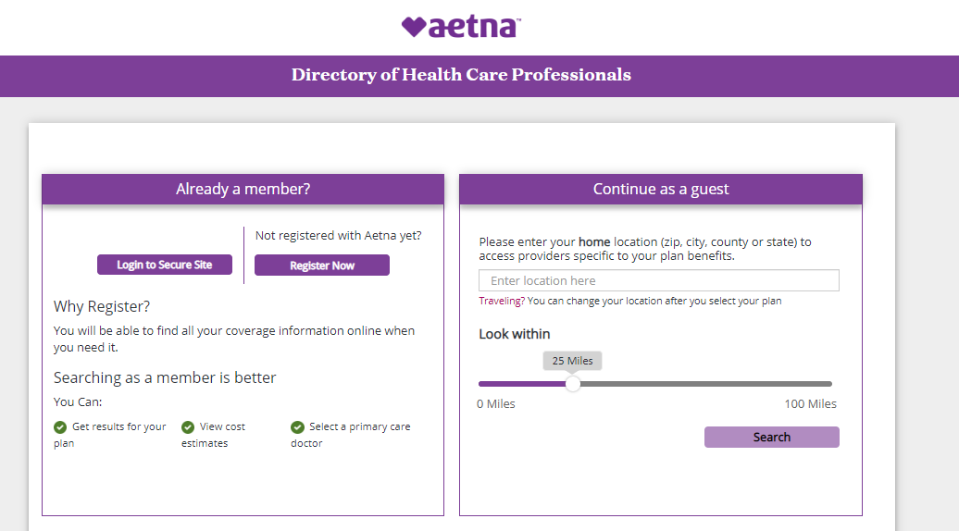
How to find a network PPO medical provider
Aetna Choice® POS II (Open Access)
www.aetna.com/loyola
SAME NETWORK FOR ALL PLANS
Aetna Choice® POS II (Open Access)

Slide 11
Identifying your Maximum Savings medical provider
Aetna Choice® POS II (Open Access)
Maximum Savings Provider will be paid
at the plans highest benefit level

Slide 12
Behavioral Health
Feeling your best
Many people live with a behavioral health condition
Behavioral therapy
Also known as talk therapy. It’s one of the main ways to treat a behavioral health condition.
Medication therapy and management
Treatment may involve taking prescription medications. There are many that are effective for treating conditions like depression and substance use disorders.
Your care advocate
They’ll work closely with you to support your emotional health and everyday needs. They can do all the legwork to help you give your emotional health the high priority it deserves.
People of any age, gender, income, race or religion can be affected by:
Anxiety
Depression
Eating disorders
Substance use disorders
Sometimes, the health conditions are mild and short lived. Other times, they’re more serious and long lasting. Either way, there are effective treatments that can help. Your medical plan includes behavioral health benefits, with the help and resources you need to work toward feeling your best.

Slide 13
Loyola Prescription Drug Plan
Medical plan participants only
No separate enrollment needed for prescription coverage
PPO 1 & PPO 2 have a separate medical and RX deductible and out of
pocket maximum
PPO 3 HSA has a combined deductible and out of pocket maximum
Complete list of participating pharmacies at www.caremark.com
Welcome Kits sent to your home address will include ID card(s)
You can use other Pharmacy Retail outlets besides CVS such as:
Walgreens
Target
Walmart
For more locations, visit the www.caremark.com website
Notes:
Everyone who enrolls in PPO 1, PPO 2 or PPO 3 will receive a new ID card from CVS at their home address. These are expected to arrive a few weeks after you enroll and submit your elections. One card will be sent for single coverage and two cards for those of you with dependent coverage. If for some reason you do not receive a card, the RX BIN and Group # would allow you to obtain a prescription at the pharmacy. You can use one of the thousands of pharmacies that are part of the CVS Caremark network including Walgreens, CVS, Jewel/Osco, Walmart, Costco, and many more. Keep in mind that some prescriptions require prior authorization in order to be covered under the plan, and some prescriptions are excluded under the plan.

Slide 14
Loyola Prescription Drug Plan
Loyola Prescription Drug Plan
Loyola Prescription Drug Plan
Loyola Prescription Drug Plan
Formulary Drug List Available online at http://info.caremark.com/druglist
PPO 3 - Some preventive prescriptions require you to only pay coinsurance, even without meeting the deductible yet
Maintenance prescriptions can be sent through mail order to your home
90 day prescriptions can be attained through CVS retail pharmacies with Mail Order
Specialty medications will be required to be filled through CVS Specialty pharmacy
program. Specialty medication details can be found online at: CVSspecialty.com/enroll OR
1-800-237-2767
How are contraceptives covered?
Prescription for contraceptives are excluded on the Loyola medical plan. However, there is a program available where by you can obtain certain contraceptive prescriptions at no cost to you, as part of the Affordable Care Act. In order to obtain these you will obtain a separate ID card. You must use this separate contraceptive ID card in order to obtain these RX at no cost.
Contact CVS at 1-888-924-8738 to enroll in contraceptive coverage

Slide 15
Aetna Resources

Slide 16
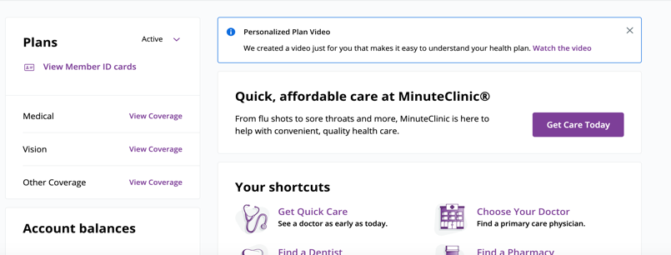
AETNA MEMBER WEBSITE
Get a quick view A streamlined interface to easily view and manage benefits
Connect to care Tools and information to find, compare and choose care
Gain fast access To ID card, coverage level and quick tasks
Manage plan info Track progress towards deductible, view and manage recent claims

Slide 17
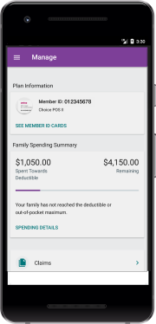
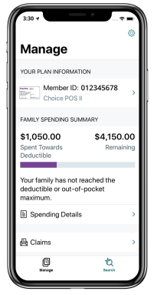
AETNA HEALTH APP
With the Aetna Health℠ app, you can manage your benefits all in one place.
Manage benefits, view and pay claims
View progress toward your deductible
Find a doctor or urgent care center
Get cost estimates before you get care
Schedule doctor appointments
Tip
You can access your ID card anytime on your phone using our Aetna Health app.

Slide 18
AETNA MEMBER RESOURCES
Use the Aetna website and/or mobile app to make the most of your benefits
Find Care
Cost of Care
Quality & Cost
Get coverage and benefits information
Use information to help make treatment decisions
Look up symptoms, conditions and medications
Find and compare doctors
Download digital ID cards
Read doctor reviews
Get estimates for your out-of-pocket costs
Track account balances and progress toward your deductible
Manage and pay claims

Slide 19
Section 3
Health Savings Accounts (HSA)
&
Flexible Spending Accounts (FSA)

Slide 20
You can contribute up to the following amounts tax free in 2021: Individual = $3,600 total or $600 Loyola + up to $3,000 Family (You +1 or more) = $7,200 total or $1,200 Loyola + up to $6,000 If you are 55 or older, you can contribute an additional $1,000 in catch-up contributions, too.
HSA
A Health Savings Account (HSA) is a bank account that allows you to save and pay for your share of everyday qualified health care expenses tax-free.
Loyola will contribute to your HSA account with the first paycheck after you enroll. Enroll in your HSA payroll contribution at https://ess.luc.edu.
Amounts below are prorated based on hire date.
$600
$1,200
Employee Only
Employee +1 or More
$1,200
Contributions are use-it or lose-it!
Notes:
4 months x $50 = $200
4 months x $100 = $400

Slide 21
HSA Q&A
How do I qualify for an HSA?
You must be enrolled in an HSA qualified health plan option (PPO 3 HSA). If addition, you cannot be covered by another health plan (including Medicare or Tricare) or be claimed as a dependent on another person’s tax return.
How do I make deposits to my HSA?
You can contribute to your account with payroll deductions, online by making deposits from your checking account, or by mailing a personal check. Loyola will deposit the University’s contribution in January 2021.
What expenses qualify for payment from an HSA?
Funds in your HSA can be used to pay for any eligible medical, dental, or vision expenses – doctor’s visits, prescriptions, lab tests, and hospitalizations. See IRS Publication 502 for a complete list of qualified expenses.
Do HSA funds expire?
Your HSA funds never expire. Any funds you don’t spend roll over year after year and can be saved and invested for retirement. There is an annual limit for contributions, but the total balance of your account has no limit.
What happens if I change jobs or health plans?
You own your HSA. If you change jobs or health plans, you continue to own your account. If you enroll in another HSA-qualified health plan, you can continue to contribute to your HSA. If you choose another type of health plan, you are still eligible to spend the funds in your HSA on qualified medical expenses — for you, your spouse, and your tax dependents.
What are the fees for having this account?
The monthly maintenance fee is employer paid by Loyola. $1.90 per employee per month if the monthly average balance is $3,000 or less. No fee if the monthly average balance is $3,000 or higher.

Slide 22
FSA
$2,750
annual limit
$2,750
annual limit
HEALTHCARE FSA
SELECT YOUR FSA ACCOUNTS
HEALTH CARE FLEXIBLE SPENDING ACCOUNT (HFSA)
LIMITED FLEXIBLE SPENDING ACCOUNT (LFSA)
DEPENDENT CARE EXPENSE ACCOUNT
TRANSIT
LIMITED FSA
Open a flexible spending account to help pay for eligible medical expenses tax free.
$10,000 (2021 only)
annual limit
DEPENDENT CARE
$270
per month
TRANSIT
Typically contributions are use-it or lose-it! Except for a $550 roll over benefit on the HFSA and the LFSA. If you do not use all of your contributions, you are eligible to carry-over $550 of remaining FSA funds to the following plan year. To carry-over the funds, you need re-enroll in the HFSA or the LFSA in the new year.
Notes:
Even when you have insurance, your copays and other expenses have a way of adding up. The good news is you’re eligible to participate in a Flexible Spending Account, or FSA. An FSA helps you save on your taxes, by allowing you to set aside tax-free money every month to pay for hundreds of eligible out-of-pocket health care expenses.
FSAs are great because the money you contribute is PRE-TAX income! It’s like getting an automatic discount on every eligible expense.
There are two main types of FSAs: a Healthcare FSA and a Dependent Care FSA. To be eligible for the Healthcare FSA, you cannot be enrolled in the HDHP with an HSA.
The use it or lose it rules apply, so consider your contributions carefully.

Slide 23
Section 4
Dental
Vision
Retirement
Life & Disability
Accident
Critical Illness
Other benefits

Slide 24
DENTAL
Dental insurance options
Delta Dental PPO
Choose in-network dentists to receive lowest costs for services
Out-of-network dentists provide services at a higher cost for you
Guardian/First Commonwealth DHMO
In-network dental care only,
Available in Chicagoland and Northwest Indiana only
No out-of-network coverage
Notes:
Loyola University Chicago's benefit-eligible faculty and staff have their choice of two Dental plans: Delta Dental PPO and Guardian/First Commonwealth (DHMO):
Delta Dental PPO provides two levels of coverage as well as an option for out of network services.
Delta Dental PPO participants are subject to annual deductible and benefit limitations based on the service level of the primary care dentist.
Guardian/First Commonwealth (DHMO) only operates in the Northern Illinois/Chicagoland & Northwest Indiana area and participants must choose a primary care dentist first, submit this information to Guardian and have an ID card with the dentist name in hand before services are rendered.
There is no annual deductible, and services rendered are not subject to maximum benefit limitations.
If you decide to change your dentist you must first call Guardian/First Commonwealth at 866-494-4542. The change process takes approximately 20 days.
An up-to-date list of the names and locations of participating dental providers may be found online: www.guardiananytime.com.

Slide 25
VISION
Vision Service Plan (VSP) provides comprehensive eye care benefits throughout the VSP network for routine services. Members also have access to discounts available at www.vsp.com.
Aetna Vision Discounts Employees and family members enrolled in our Aetna medical plan are eligible for vision savings under Aetna's EyeMed vision discount program. Please keep in mind this is not insurance but a discount savings program. Visit www.aetna.com for more information and to find a location.
Notes:
As you know, the VSP insurance plan provides coverage that includes an eye exam every 12 months for a $10 copay, and frames and lenses for a $25 copay, and there is a maximum allowance on the plan. You can still go wherever you would like, but coverage is limited outside of the network. Retail providers like Costco, EyeMasters and Visionworks

Slide 26
Retirement
403(b) Defined Contribution Retirement Plan (DCRP) administered by Transamerica
Can enroll and make own contributions to the plan beginning with your date of hire.
Automatic enrollment in employee contributions after 60 days of employment.
Will be automatically enrolled in employee contributions at 1%.
Automatic Increase/Automatic Save program - annual contributions will increase by 1% until a max of 5% is reached.
Eligible to receive Loyola Employer Contribution of 5% and Match Contributions up to 5% based on your date of hire.
Will receive the Loyola Employer contribution and Match contribution after 1 year of employment.
You are vested at 50% at your 1 year anniversary, and 100% after 2 years.
Maximum Contribution of $19,500 for 2021.
Participants age 50 and over can contribute an additional $6,000.
You can change contributions and investments at any time online at www.luc.trsretire.com or by contacting the Transamerica Retirement Center 773-508-2770.

Slide 27
LIFE & DISABILITY
Employee Life Insurance
Basic Life automatically provided at 1.5x salary to a max of $500,000
Voluntary Supplemental Life Insurance.
You - Up to 5x salary ($500k max)
Guarantee Issue $250k when first eligible
Dependent Life Insurance
Spouse – Up to 100% of your approved amount
Maximum of $100,000
Guarantee Issue $25k when first eligible
Child(ren) – $5k ($1k < 6 months) Guarantee Issue (no health questions)
Short-Term Disability – The University automatically provides Short-Term Disability (STD) coverage to all full-time benefit-eligible faculty.
Long Term Disability – The University automatically provides Long-Term Disability to all full-time benefit-eligible faculty.
Notes:
As an eligible employee, you are covered for 1½ times your annual salary for life and accidental death and dismemberment insurance. This is paid by Loyola. And insured by Reliance Standard. You also have short and long term disability coverage through Reliance if you are full-time benefit-eligible. This also is paid for by Loyola. In addition, you can purchase supplemental life insurance for you, up to 5 times your salary. If this is the first time you are eligible for this coverage, then you can elect up to $250,000 without having to answer any health questions. Amounts you request in excess of $250,000 are subject to Evidence of Insurability, or, if this is not the first time you were eligible to buy this coverage, then you are also subject to evidence of insurability for any amounts you are requesting. This means you will answer some health questions to determine if Reliance will accept or decline your application for coverage. You can also purchase coverage for your spouse, but you must purchase coverage on yourself to buy insurance on your spouse or children. Evidence of insurability may also be required on your spouse as well. Premiums of age rates and the rate tables are posted online through the Loyola HR website. You can also purchase voluntary accidental death and dismemberment coverage. There are one of four coverage levels you can purchase.

Slide 28
Accident Plan
Pays a lump sum benefit when you seek treatment for injuries sustained in an accident
Benefits paid directly to you
Annual wellness visit benefit of $75
24 hour coverage
Guarantee Issue & no waiting periods
No limit to the number of times you and your family can use the plan
Accident coverage is provided at no cost to employees who enroll in PPO 3 HSA
(coverage for other dependents may be purchased voluntarily)

Slide 29
Critical illness
Critical Illness (CI) pays a Lump sum benefit directly to you upon diagnosis of a covered critical illness.
$10,000 CI coverage is provided at no cost to employees who enroll in
PPO 3 HSA
(coverage for other dependents may be purchased voluntarily)
Additional costs due to a critical illness contribute to pressure you are already under at the worst possible time
Out-of-pocket medical expenses
Durable Medical Equipment
Lost income
Home modification
You choose either a $10,000 or $20,000 lump sum benefit
This benefit includes a wellness benefit – if you receive a health screening you will receive $50.

Slide 30
OTHER Benefits
Employee Assistance Program (EAP)
Mental health is important. If you or someone that you are caring for are in need of
mental health and wellness support, please utilize the (EAP) at 800.456.6327
Pre-paid legal
Tuition benefit
Child care tuition benefit (Kindercare)
Pet insurance
Employee discounts - www.luc.edu/hr/discounts
Quarterly Wellness Program
Notes:
Visit www.luc.edu/hr to find information on a variety of other benefits available to you, including:
Tuition benefits
Kindercare
Employee Assistance Program (EAP)
Credit union
EMERGE & Skillsoft training programs
WW (Weight Watchers Reimagined)
Employee discounts - www.luc.edu/hr/discounts
AAA and other travel-related services
Divvy
Equinox
Computers/software
Cell phone bills
And many more!
In partnership with our Wellness provider Health Maintenance Institute (HMI), you have the opportunity each quarter to earn wellness points and earn a $75 reward (taxable) incentive for living a healthier lifestyle
Next quarter begins September 16th through December 31st
Must earn 125 wellness points
Participate in various wellness activities to earn points
Sign up and log your activity on the HMI Wellness Portal:
Myhmihealth.com
Site Code L773

Slide 31
Section 5
Enrolling in benefits
&
Questions and answers

Slide 32
Enrolling in benefits
Spousal/LDA Premium
FSA elections
Verify dependents and beneficiaries
Talk to ALEX
Tobacco Premium
Employee Self-Service (ESS)
Complete your new hire benefit enrollment in ESS within 31 days of your start date.
Visit ALEX: www.myalex.com/loyola/2021
Notes:
AGAIN, reminder that you have 31 days maximum from the date you are eligible to make your elections for the remainder of this year. You must go out to the self service portal and choose which plans you want or waive the plans you don’t want. Lastly, remember that when you are enrolling, you and your covered spouse/LDA must complete the tobacco and spousal/LDA certification to avoid increased premiums. This must be done by both you and your spouse/LDA if you are covering them on one of the Loyola medical plans.
If you wish to waive benefits, please log into Employee Self- Service to do so.
Enrolling in Transit:
Visit loyolaexpress.com
Need assistance in picking a benefits package?
Don’t forget about ALEX - your personal benefits counselor: www.myalex.com/loyola/2019
Premium rates and other information can be found online
on the Human Resources website and in the Benefits Booklets at www.luc.edu/hr/benefits

Slide 33
Section 6
Questions and Answers

Slide 34
Benefit Questions…
Feel free to contact benefits@LUC.edu or 312.915.6175 with any benefits-related questions.

Slide 35
Thank You !

